Slide 1
Valuing S&P BSE 100
Approach and Methodology Paper
January, 2026
Report Prepared by: Karn Sharma
Guided by: Parth Verma (Founder of The Valuation School)

Slide 2
Contents
1 | Purpose
2 | About the Index
3 | Approach and Methodology
4 | Valuation
5 | Sources and Disclaimer

Slide 3
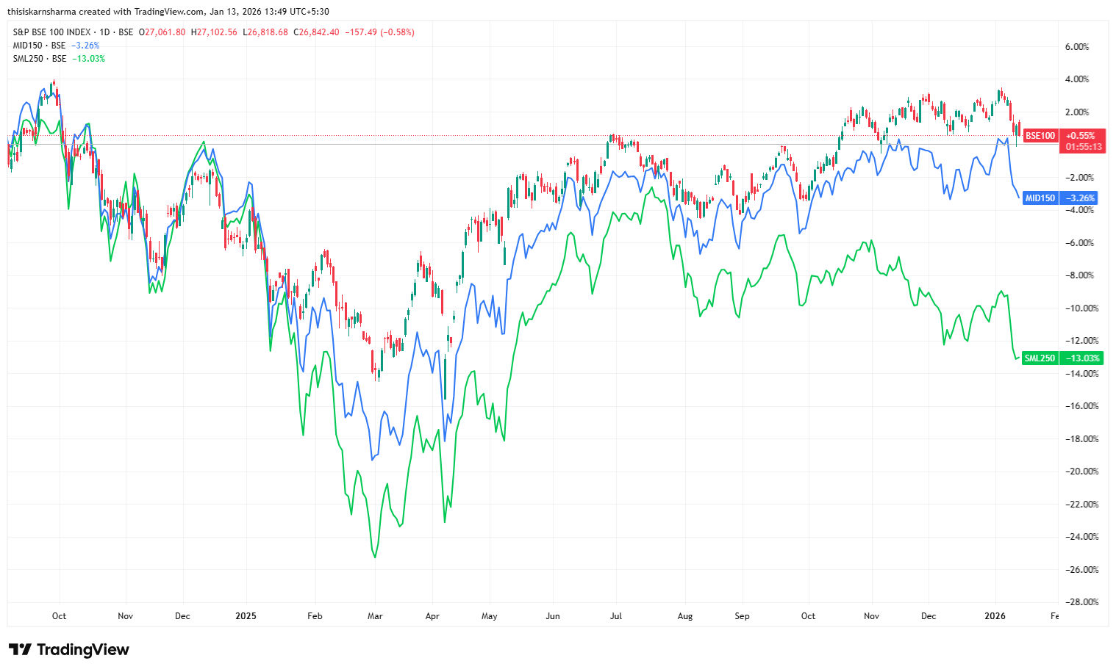
1. Purpose
1.1 Brief 6-month Recap
Over the past six months the BSE 100 has shown low positive returns of around 3.3 percent, climbing from lower levels toward a near 52-week high and all-time high amid market consolidation.
Favorable domestic investor sentiment along with stable earning in large-cap constituents, have pulled the index upwards since March 2025, despite geopolitical volatility and mixed sector performance affecting its momentum.
The image is a representation of BSE 100’s consolidation state over the past one year in relation to BSE’s small and midcap indices. From the start of 2025, top 100 stock have been able to withstand geopolitical currents, while small and midcap market witnesses a slump.

Slide 4
1. Purpose
1.2 Purpose
The primary purpose of this methodology paper is not to determine the exact valuation of the BSE 100 Index. It simply applies Prof. Aswath Damodaran’s valuation principles and techniques that he uses in the valuation of equity instruments. Given the availability of the information and the current state of the Indian Equity markets, this model relies heavily on proxies for cash flows and assumption rates. The results therefore signify only what the I believe are the best possible metrics that can be used in order to reach an approximated intrinsic value of this index. This is nothing but a demonstration of Damodaran’s principles being applied to the financials of an index, helping me building a foundation of how a DCF model works.

Slide 5
Contents
1 | Purpose
2 | About the Index
3 | Approach and Methodology
4 | Valuation
5 | Sources and Disclaimer

Slide 6
2. About the Index
2.1 About
The BSE 100 is India's benchmark stock index tracking the performance of the top 100 large-cap, highly liquid companies listed on BSE, reflecting diverse sectors and the broader Indian economy, weighted by free-float market capitalization, and serves as a key gauge for investors and fund managers to assess market health and investment performance.
2.2 Purpose
To track the performance of the top 100 blue-chip companies, serving as a benchmark for large-cap Indian equities
2.3 History
Launched in 1989 (originally called BSE National Index) and later renamed
2.4 Composition
Given along is the sector composition of the Index based on the top 100 large-cap Indian Stocks’ respective sectors.
Sector | Weightage %
Basic Materials | 6.37
Consumer Cyclical | 10.6
Financial Services | 34.97
Real Estate | 0.32
Communication Services | 4.63
Energy | 9.75
Industrials | 8.05
Technology | 9.96
Consumer Defensive | 7.67
Healthcare | 4.41
Utilities | 3.26

Slide 7
Contents
1 | Purpose
2 | About the Index
3 | Approach and Methodology
4 | Valuation
5 | Sources and Disclaimer

Slide 8
3. Approach and Methodology
3.1 Expected Dividend & Buybacks
In a DCF framework, valuation is obtained by discounting Free Cash Flows to Equity (FCFE) at an appropriate rate. However, estimating FCFE for each constituent of the BSE 100 is operationally intensive. As an alternative, expected dividends and buybacks, which are economically equivalent to FCFE, are used as proxies based on historical patterns.
Dividend data is readily available from the BSE, while buybacks are relatively infrequent among BSE 100 companies. Hence, buyback yield estimates consolidated by Professor Damodaran, based on buybacks relative to total earnings and dividends, are used. Given the negligible buyback activity in emerging markets such as India, its impact on valuation remains limited.
Period | Dividend Yield | Buyback Yield | Total Yield
20 Years | 1.18% | 0.29% | 1.47%
15 Years | 1.34% | 0.17% | 1.51%
10 Years | 1.12% | 0.23% | 1.45%
5 Years | 1.24% | 0.19% | 1.43%
3 Years | 1.21% | 0.23% | 1.44%

Slide 9
3. Approach and Methodology
3.2 Expected Growth in BSE 100 Earnings
The earnings of the BSE 100 can be derived by dividing the index level by its price-to-earnings ratio, to get a growth rate (CAGR) that justifies the earning trend in the constituent companies. Both the index level and PE ratio are sourced from the BSE website, allowing earnings and their growth to be estimated with limited additional analysis.
A key consideration is the choice of growth rate for valuation. As the difference between the 3-year and 10-year average compounded earnings growth is marginal (within ±1%), a 10-year compounded growth rate is adopted as it represents a better historical average and justifies the trend better over the years.
Compounded Years | CAGR Earning Growth %
10 Years | 12.37%
7 Years | 12.23%
5 Years | 11.59%
3 Years | 10.88%

Slide 10
3. Approach and Methodology
3.3 Risk free Rate – 10 Yr Indian Government Bond Yield
The risk-free rate is a fundamental input in DCF valuation and represents the opportunity cost of capital. Conventionally, the 10 Yr government bond yield is used as the risk-free rate. While this rate may be adjusted for country and default risk, limited historical data for emerging markets makes such adjustments challenging.
The choice of an appropriate risk-free rate can be debated. Given that an emerging market like India experienced government bond yields as high as 12% during the 1990s, and to maintain a forward-looking perspective, the most recent available rate (January 2026) is used for valuation in this paper.
Compounded Years | CAGR Earning Growth %
20 Years | 7.41%
15 Years | 7.32%
10 Years | 6.72%
5 Years | 6.81%
As on January 1, 2026 | 6.6%

Slide 11
3. Approach and Methodology
3.4 Implied Equity Risk Premium (ERP)
The equity risk premium is the additional return that’s expected on an index or portfolio of investments above the given risk-free rate. It is an incentivise for assuming risk beyond government bonds over equity markets in general. A higher ERP indicated a cautious market where the investors are defensive while investing in equities and represent their willingness to pay a lower price for the same cash flows and earnings.
Implied ERP is reverse engineered by considering current index value and expected FCFEs. Here, again, the latest ERP seems like the best approach just like the risk-free rate
Compounded Years | CAGR Earning Growth %
20 Years | 2.51%
15 Years | 2.26%
7 Years | 1.79%
5 Years | 1.66%
Latest | 2.70%

Slide 12
Contents
1 | Purpose
2 | About the Index
3 | Approach and Methodology
4 | Valuation
5 | Sources and Disclaimer

Slide 13
4. Valuation
This is a dynamic table, the rates are adjustable
*The perpetual growth rate used in the calculation of the Terminal Value is 7.4%, which is the growth rate of GDP, representing the Indian economy’s growth rate

Slide 14
Contents
1 | Purpose
2 | About the Index
3 | Approach and Methodology
4 | Valuation
5 | Acknowledgement and Sources

Slide 15
5. Acknowledgment and Sources
5.1 Acknowledgment
Report Prepared by: Karn Sharma
Guided by: Parth Verma (Founder of The Valuation School)
5.2 Sources
https://in.investing.com/
https://www.bseindia.com/
https://www.morningstar.in/
https://www.market-risk-premia.com/
Research Paper: “Estimating Risk-Free Rates” by Prof. Aswath Damodaran
https://www.screener.in/
https://www.moneycontrol.com/
5.3 Disclaimer
This index valuation report and the accompanying model have been prepared solely for academic and informational purposes. They do not constitute investment advice, a recommendation, or an offer to buy or sell any securities or financial instruments. The valuation framework, assumptions, parameters, and methodologies employed are inherently subjective and reflect the author’s judgment based on publicly available information and data accessible at the time of analysis. Actual market outcomes may differ materially due to changes in economic conditions, market dynamics, data revisions, or other unforeseen factors. No representation or warranty is made regarding the accuracy, completeness, or reliability of the analysis, and the author accepts no responsibility for any losses arising from reliance on this report.

